Slide 1
ICMP and Traceroute

Slide 2
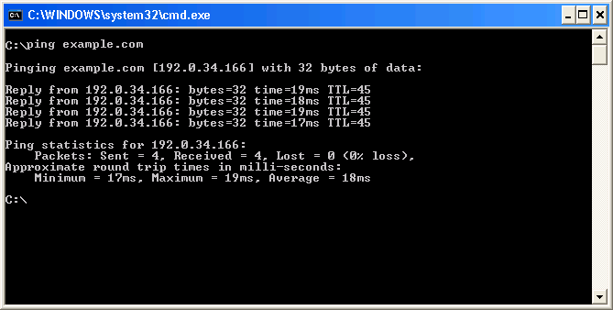
Host-Based Tools: ping

Slide 3
ping
Router# ping [[protocol {host-name | system-address}]
  To diagnose basic network connectivity, use the ping command in user EXEC or privileged EXEC mode.

Slide 4
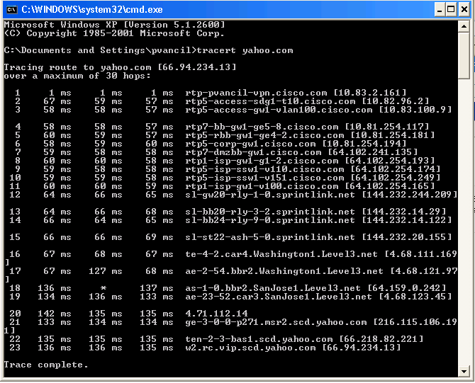
Host-Based Tools: tracert

Slide 5
traceroute
Router# traceroute [protocol] destination
  To discover the routes that packets will actually take when traveling to their destination address, use the traceroute command in user EXEC or privileged EXEC mode.

Slide 6
Redundancy in Static Route
IP SLA

Slide 7
Cisco IOS IP SLA
Cisco IOS IP Service Level Agreement (SLA) performs network performance measurement within Cisco System devices.
IP SLA actively sends data across the network in a continuous, reliable, predictable manner to measure performance between multiple network locations or across multiple network paths.
The following steps are required to configure Cisco IP SLA:
  Define one or more probes.
  Define one or more tracking objects.
  Define the action for each tracking object.

Slide 8
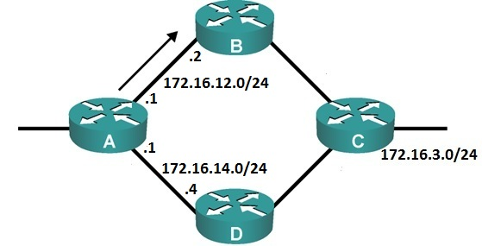
Using IP SLA
The administrator can use IP SLA for choose the primary path and backup path for a topology using only static routing.
Considering the following example:
The administrator at router A wants to use the path transit through B as the primary path to subnet 172.16.3.0/24 and the path transit through D is used as the backup path.
The routing technique is used is static routing.

Slide 9
Using IP SLA (Cont.)
Static routes on router A are configured using AD to establish primary route and backup route:
A(config)#ip route 172.16.3.0 255.255.255.0 172.16.12.2 5
A(config)#ip route 172.16.3.0 255.255.255.0 172.16.14.4 10
With the configuration above, if the link connect router A and router B down, static route with next – hop is router D will be used to forward traffic to subnet 172.16.3.0.
However, if the link is down at router B, router A cannot discover this breakdown and the redundancy is not perfomed.
The solution to the above issue is to use Cisco IP SLA functionality , which can be used to continuously check the reachability of a specific next – hop IP and conditionally announce the static route if the connectivity is verified.

Slide 10
Using IP SLA (Cont.)
A(config)#ip sla 1
A(config-ip-sla)#icmp-echo 172.16.12.2 source-ip 172.16.12.1
A(config-ip-sla-echo)#frequency 10
A(config-ip-sla-echo)#exit
A(config)#ip sla schedule 1 start-time now life forever
Set the probe to send an ICMP packet every 10 seconds to IP address 172.16.12.2.
Start sending packets now and continues forever.
A(config)#track 1 ip sla 1 reachability
Define the tracking of object 1 linked to IP SLA 1.
A(config)#ip route 172.16.3.0 255.255.255.0 172.16.12.2 5 track 1
Announces the static route with next – hop IP 172.16.12.2 with administrative distance of 5 if tracking object 1 is true.

Slide 11



phamthaikhanh@gmail.com
This Photo by Unknown Author is licensed under CC BY-NC

